Slide 1
SCULPTURE PAINTINGS
Sami Arpa, Sabine Süsstrunk, and Roger D. Hersch
School of Computer and Communication Sciences
EPFL, Switzerland
EXPRESSIVE 2018

Slide 2
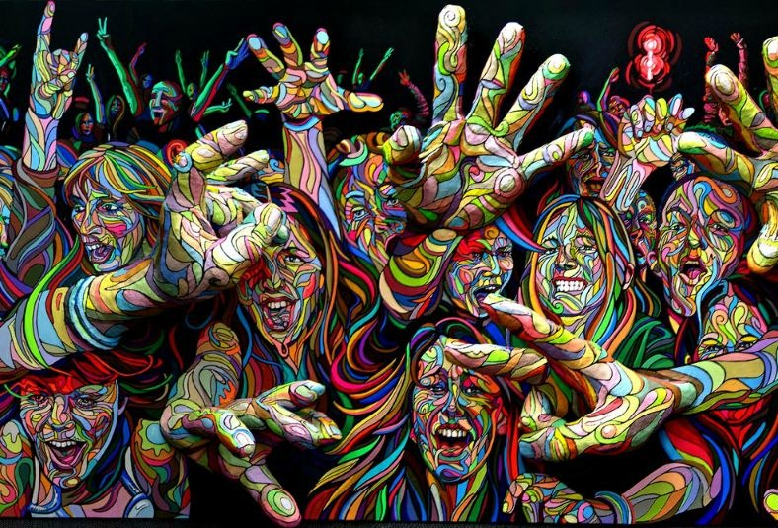
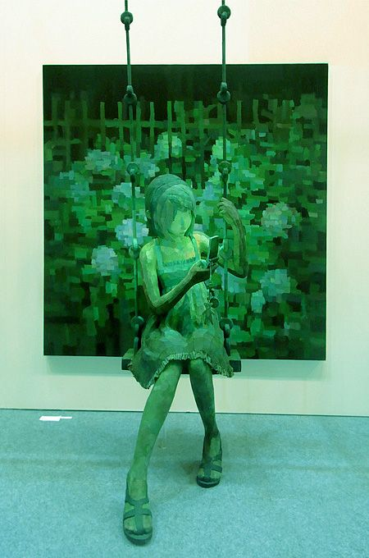
SCULPTURE PAINTINGS
Left: Marchal Mithouard, Right: Shintaro Ohata

Slide 3
Notes:
A NEW VISUAL EXPERIENCE

Slide 4
CHALLENGES
Geometry
Continuity between 2D and 3D parts.
Perception
Shading consistency, plausible perception from different viewing angles and under different illumination conditions.

Slide 5
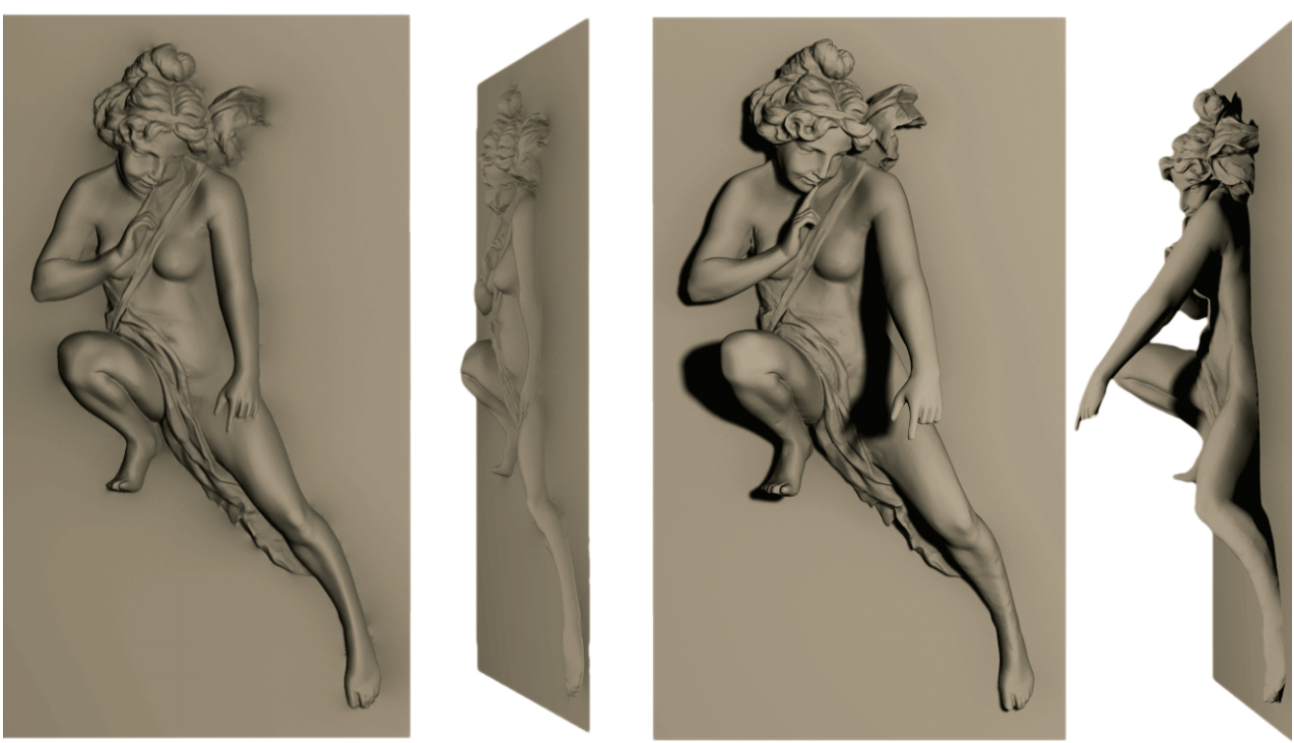
LITERATURE
Bas relief
[Weyrich et al. - SIGGRAPH 2007]
High relief
[Arpa et al. – EUROGRAPHICS 2015]

Slide 6
OVERVIEW

Slide 7
OVERVIEW
Finding the region of interest (ROI).
Refining the scene geometry.
Creating rendering plane.
Attaching flat part and ROI.
Addition of textures and bas relief profiles.

Slide 8
REGION OF INTEREST (ROI)
$v_{i}^{z}≤h_{z}$ + $β$ $∙η$
$$v_{i}^{z}:$$
z coordinate of the vertex
$$h_{z}:$$
z coordinate of the cut plane
$$β :$$
Weighting factor (e.g. 0.2)
$$η :$$
Average edge length

Slide 9
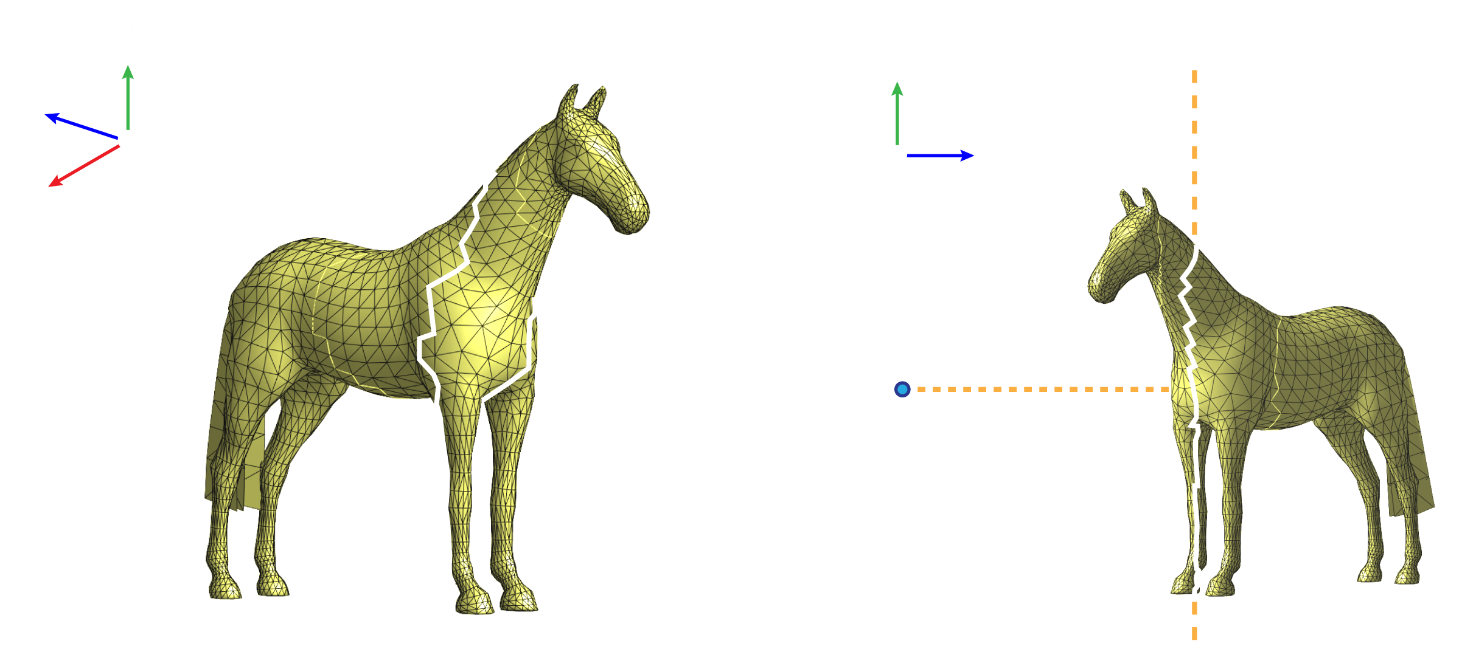
BOUNDARY EXTRACTION
Boundary

Slide 10
BOUNDARY EXTRACTION
Cut plane
Camera

Slide 11
DIFFERENTIAL COORDINATES
Δ $v_{i}=\frac{1}{\left|φ\right|}\sum_{j∈N}{ω_{j}{(v}_{i}−v_{j}) }$
$$v_{i}:$$
The coordinates of a vertex
$$N:$$
The set of neighbour vertices
$$φ :$$
The normalization factor, Voronoi area
$ω_{j}=\frac{1}{2}$ (cot $α_{ij}+cot β_{ij}$)
Sorkine, Laplacian Mesh Processing, Eurographics STAR, 2005
Notes:
As rigid as possible deformations.

Slide 12
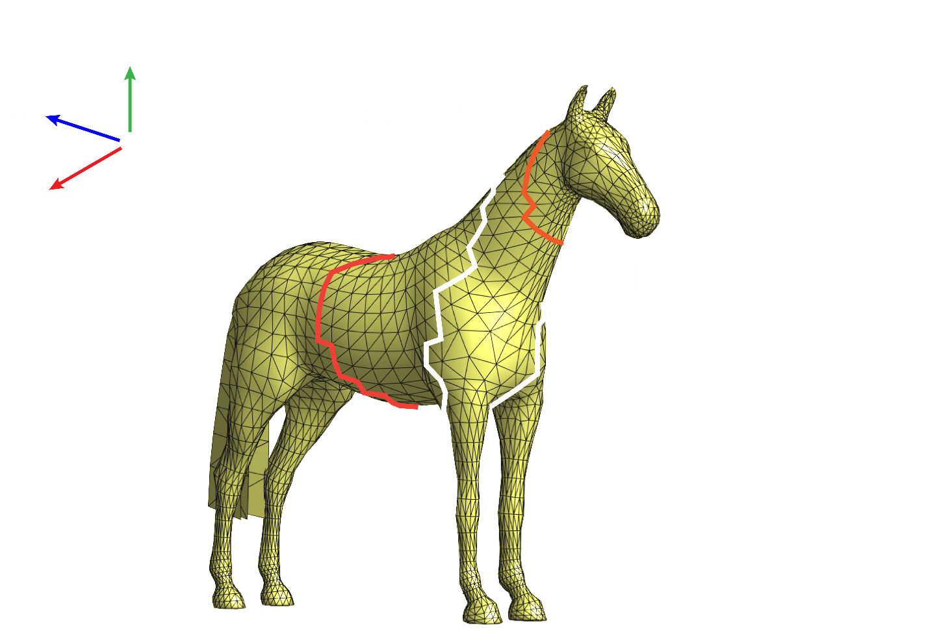
ROI REFINEMENT

Slide 13
ROI BOUNDARY
Cut plane
1. Align boundary vertices with the cut plane (camera direction).
2. 1D Gaussian smoothing over boundary polygon (orthogonal directions).
Camera

Slide 14
ROI REFINEMENT
$$E\left(v_{1}, …,v_{n}\right)= \sum_{i=1}^{n}{{\left\|Δv_{i}^{′}−{Δv}_{i}^{}\right\|}^{2}+}\sum_{j=1}^{m}{{\left\|v_{j}^{b}′−v_{j}^{b}\right\|}^{2}+}\sum_{k=1}^{d}{{\left\|v_{k}^{f}′−v_{k}^{f}\right\|}^{2}}$$
$$Δv_{i}^{′}:$$
Differential coordinates of vertex
$$v_{j}^{b}:$$
Boundary vertex
$$v_{k}^{f}:$$
Fixation boundary vertex
$$n :$$
Number of vertices
$$m:$$
Number of boundary vertices
$$d:$$
Number of fixation boundary vertices

Slide 15
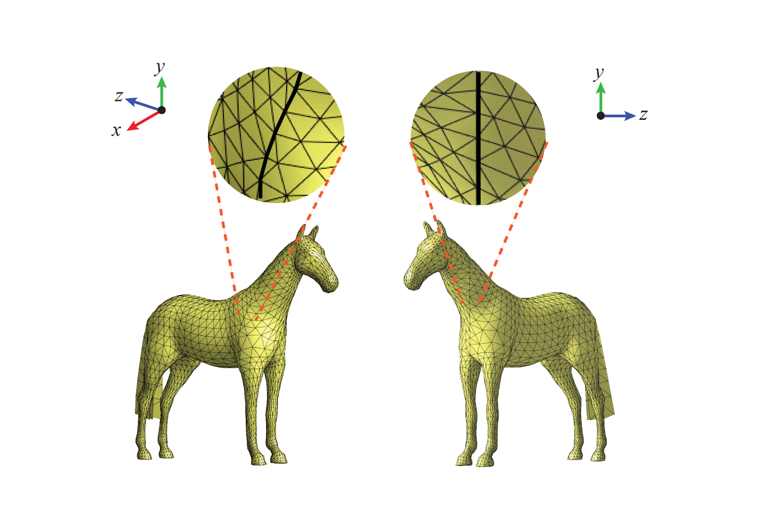
ROI REFINEMENT

Slide 16
ROI REFINEMENT
ROI
without refinement
Non-ROI
after refinement
ROI
after refinement

Slide 17
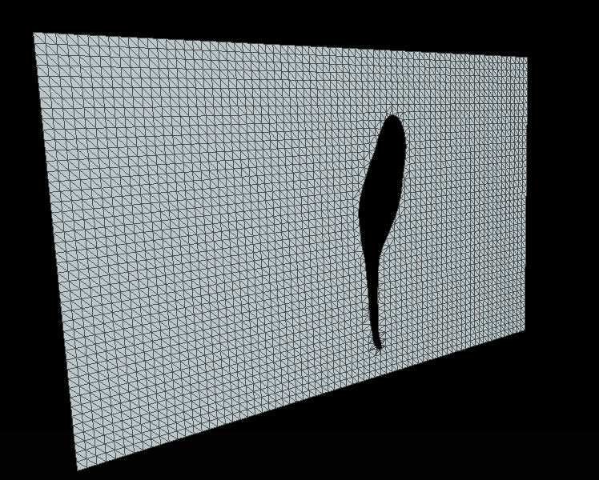
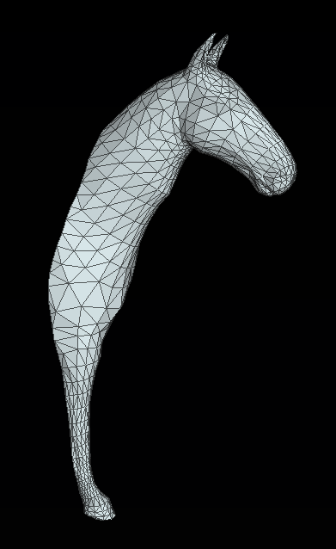
RENDERING PLANE

Slide 18
RENDERING PLANE
$$a= \frac{σ}{n}\sum{\left\|b_{i}^{′}−b_{i+1}^{′}\right\|}$$
$\#$ rows $q=w/a$
$\#$ columns r $=h/a$
$$σ :$$
Resolution weight
$$b_{i}:$$
Boundary position
$$n:$$
Number of boundary vertices
$$w:$$
Width of rendering plane
$$h:$$
Height of rendering plane

Slide 19
RENDERING PLANE

Slide 20
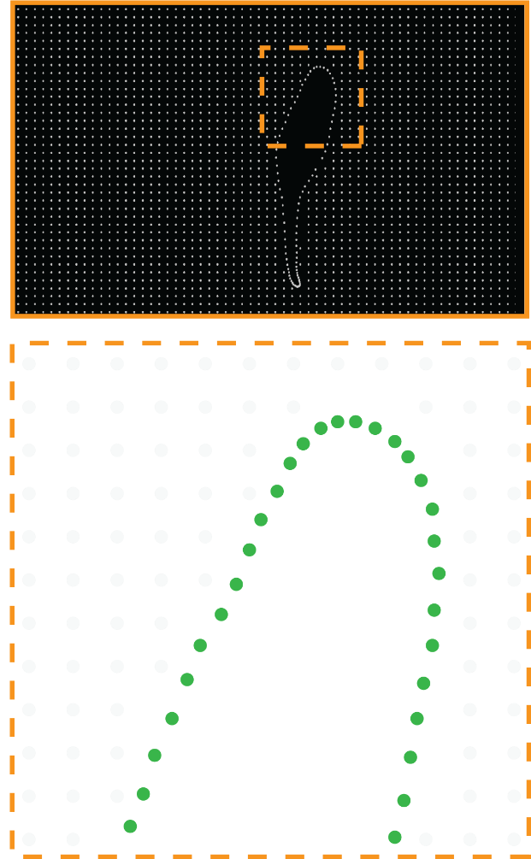
RENDERING PLANE

Slide 21
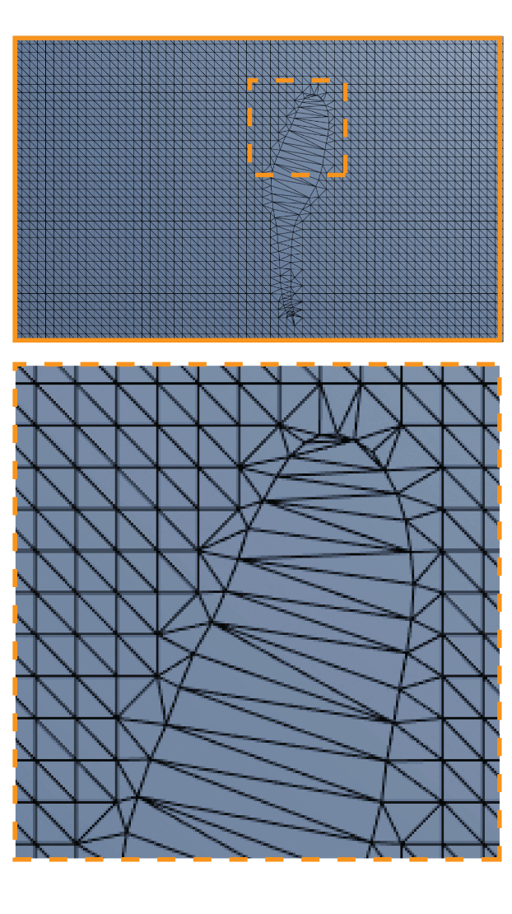
RENDERING PLANE

Slide 22
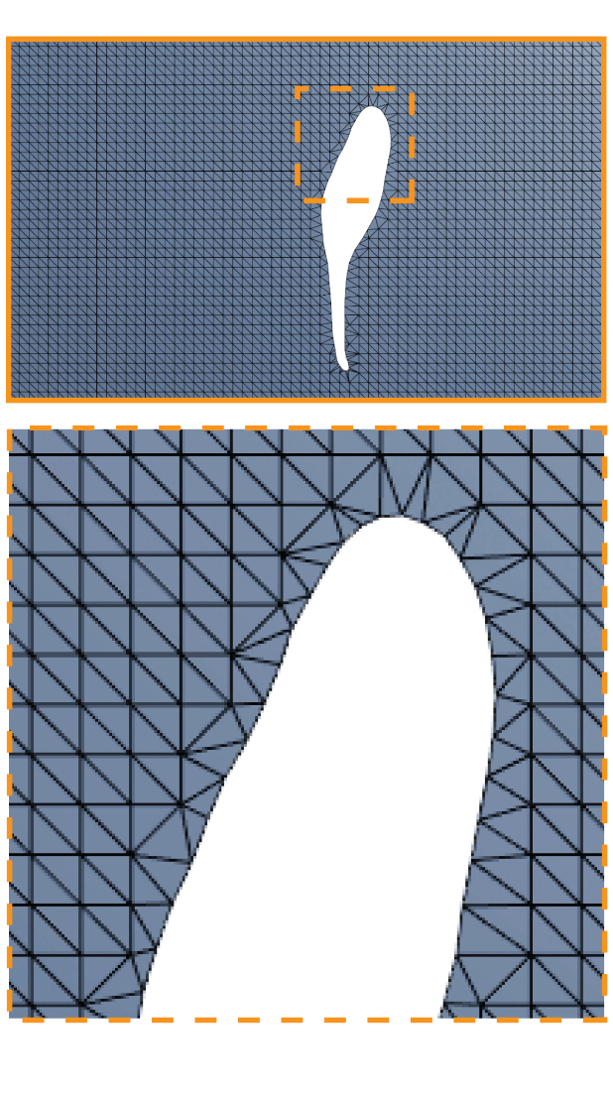
RENDERING PLANE

Slide 23
RENDERING PLANE

Slide 24
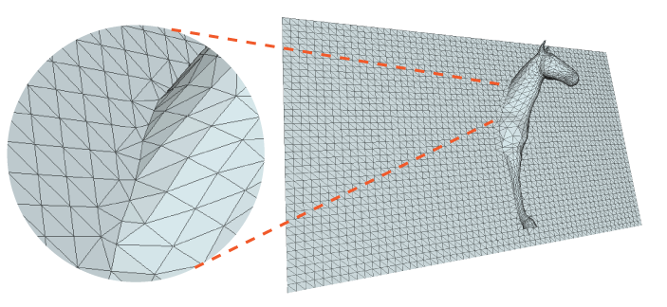
ATTACHMENT

Slide 25
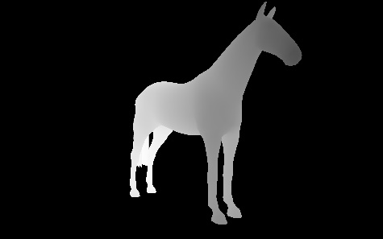
BAS RELIEF PROFILES
Heightfield representation of the scene.

Slide 26
BAS RELIEF PROFILES
Find gradients $(\frac{{∂v}_{i}^{d}}{∂x},\frac{{∂v}_{i}^{d}}{∂y})$.

Slide 27
SILHOUETTE VERTICES
$$\left\|(\frac{{∂v}_{i}^{d}}{∂x},\frac{{∂v}_{i}^{d}}{∂y})\right\|>s$$
$$s:$$
Silhouette threshold

Slide 28
BAS RELIEF PROFILES

Slide 29
BAS RELIEF PROFILES
$$E\left(\left.v_{1}(z), …,v_{n}(z\right)\right)= \sum_{i=1}^{n}{{\left\|\left.Δv_{i}^{′}(z)−{Δv}_{i}^{}(z\right)\right\|}^{2}+}\sum_{j=1}^{h}{{\left\|\left.v_{j}^{s}′(z)−v_{j}^{s}(z\right)\right\|}^{2}}$$
$$Δv_{i}^{′}(z):$$
z coordinate of differential coordinates
$$v_{j}^{s}′(z):$$
z coordinate of silhoutte vertex
$$n :$$
Number of vertices
$$h:$$
Number of silhouette vertices

Slide 31
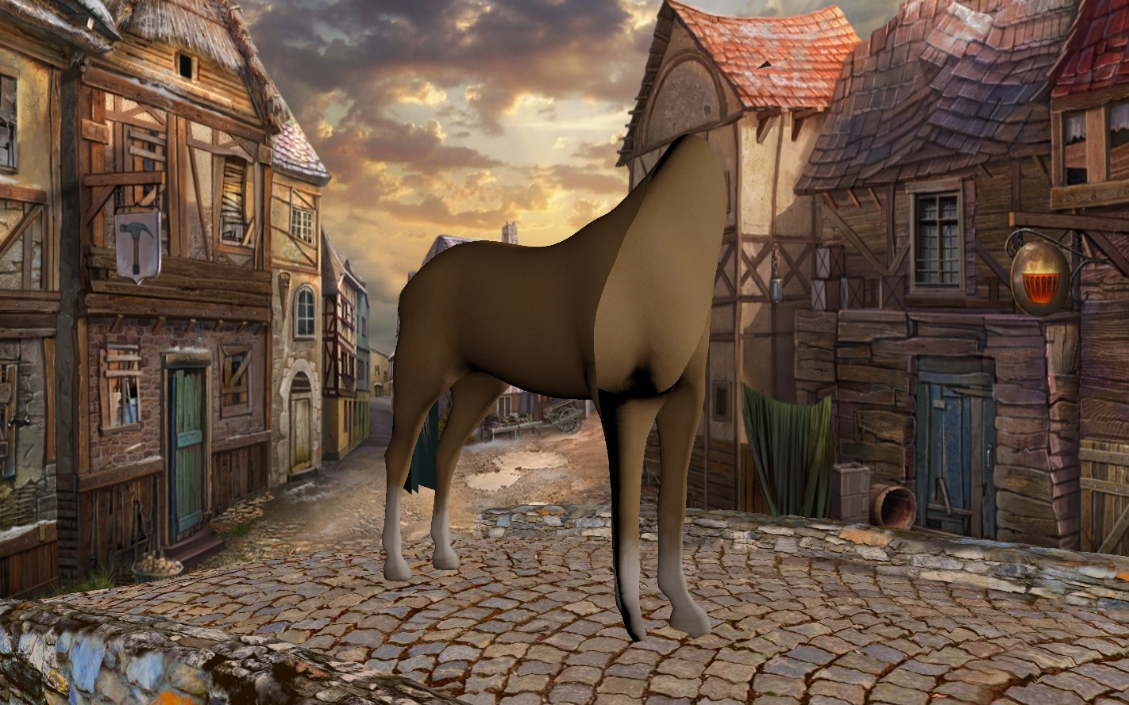
TEXTURES

Slide 32
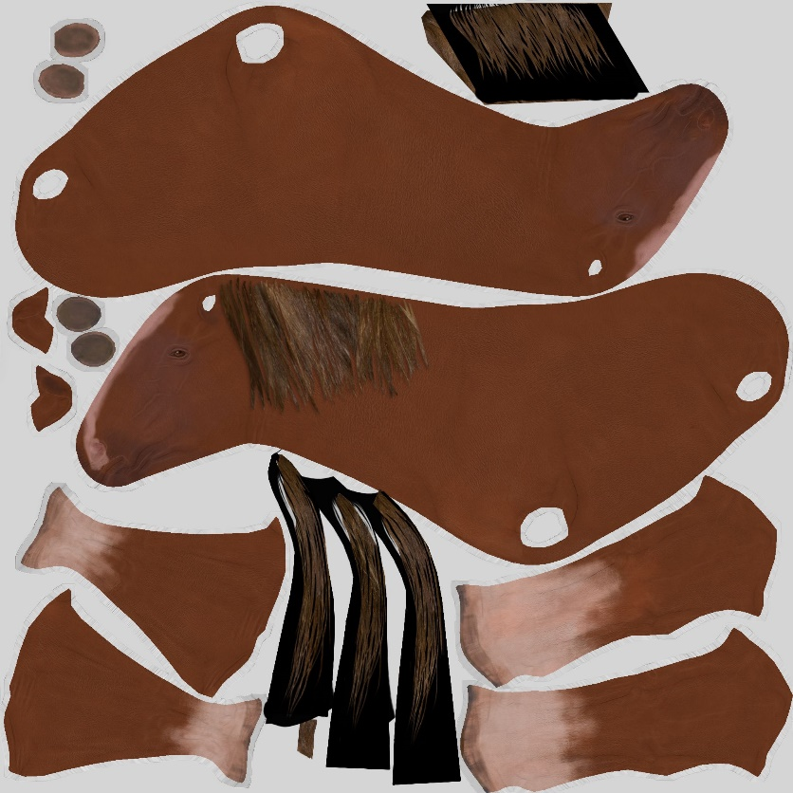
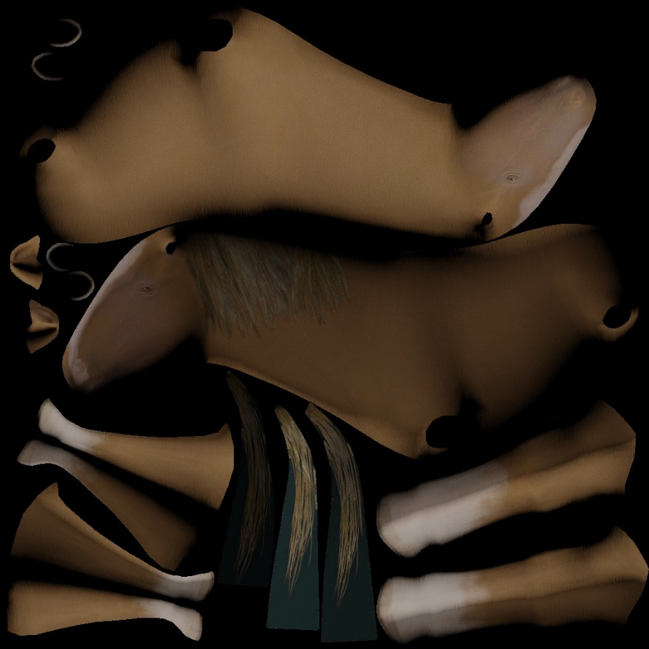
TEXTURES

Slide 34
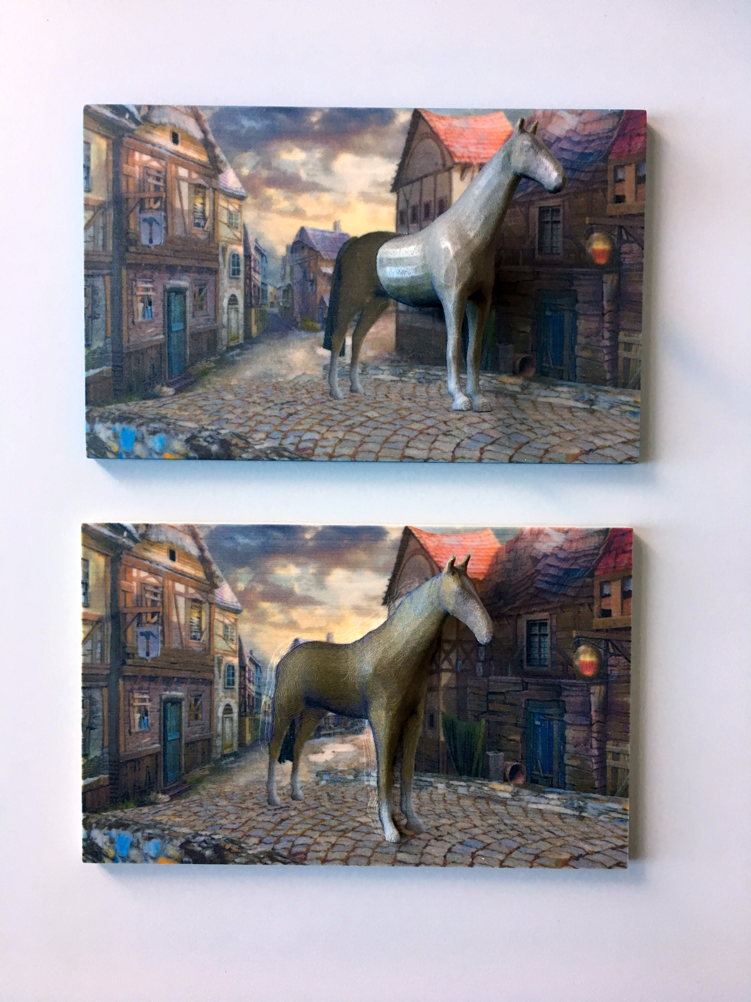

Slide 37
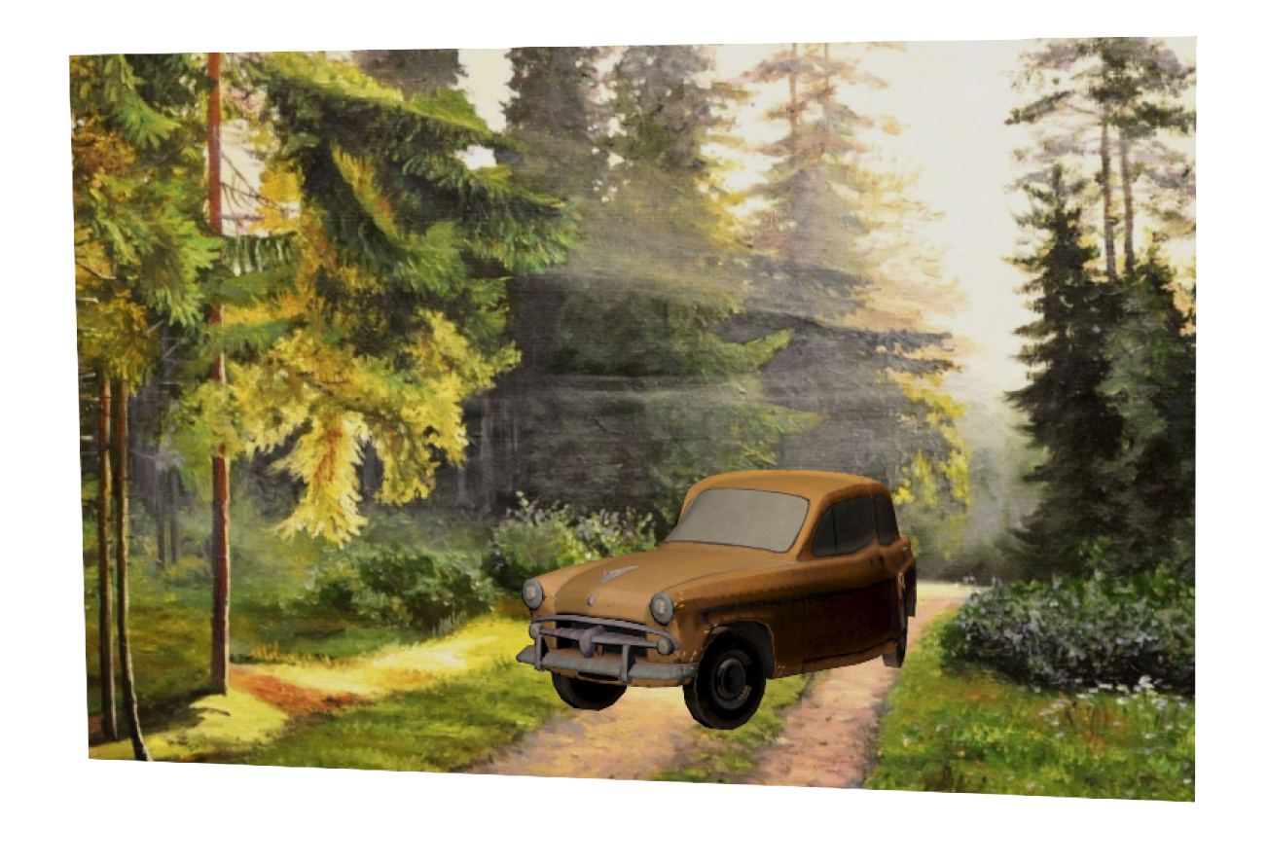
RESULTS
Lighting contradictions
Specularity, shadows, discontinuity around the boundary.

Slide 38
RESULTS
Lighting contradictions
Specularity, shadows, discontinuity around the boundary.
Viewing angle ambiguity
Depending on the scene.

Slide 39
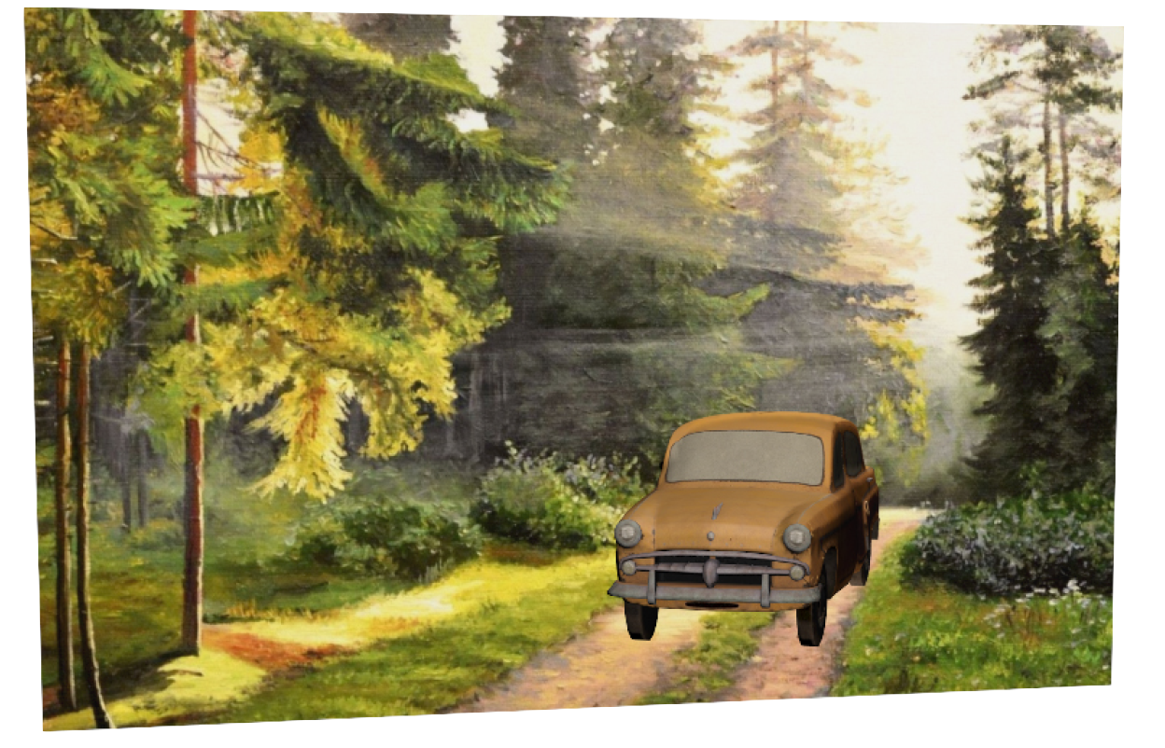
RESULTS
Lighting contradictions
Specularity, shadows, discontinuity around the boundary.
Viewing angle ambiguity
Depending on the scene.

Slide 40
RESULTS
Lighting contradictions
Specularity, shadows, discontinuity around the boundary.
Viewing angle ambiguity
Depending on the scene.

Slide 41
RESULTS
Lighting contradictions
Specularity, shadows, discontinuity around the boundary.
Viewing angle ambiguity
Depending on the scene.
Cut position
Multiple boundary problem.

Slide 42
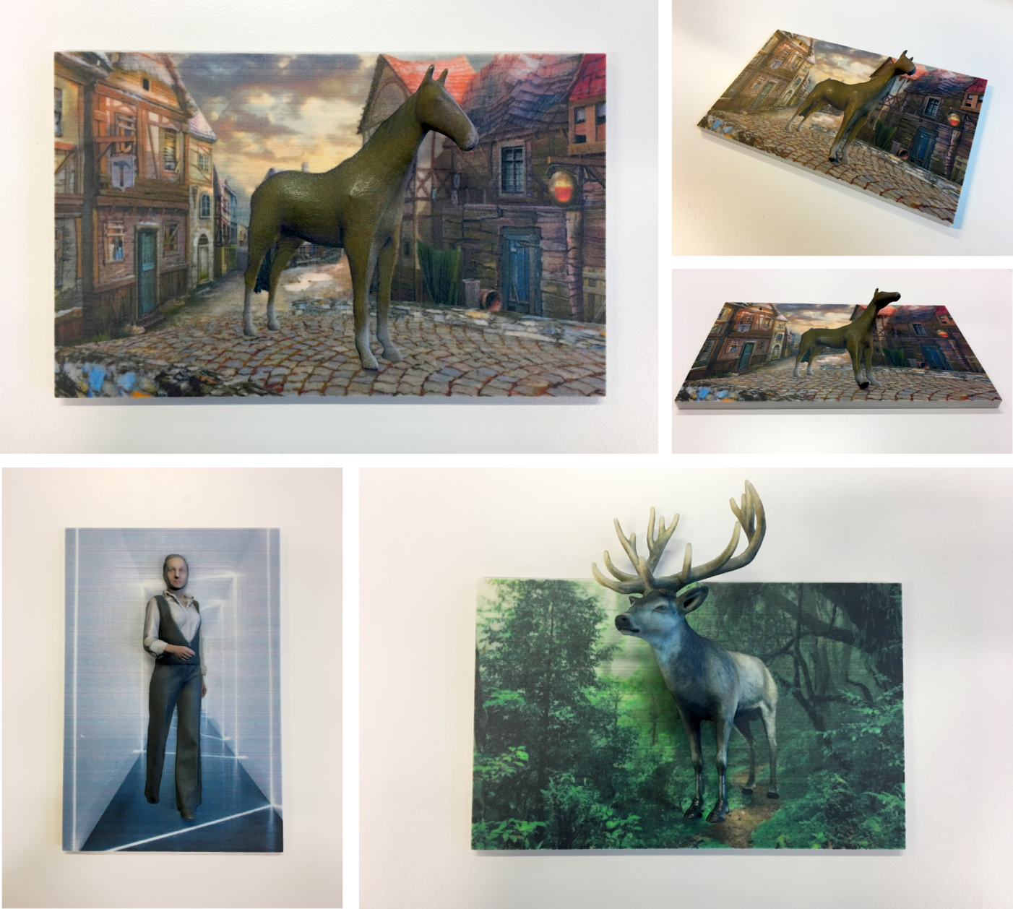
THANK YOU

Slide 43
REFERENCES
Weyrich, T., Deng, J., Barnes, C., Rusinkiewicz, S., and Finkelstein, A.
"Digital bas-relief from 3D scenes"
ACM Transactions on Graphics (TOG) 26.3. 2007.
Arpa, S., Süsstrunk, S., and Hersch, R.D.
"High reliefs from 3D scenes"
Computer Graphics Forum. 34/2. 2015.
Sorkine, O.
"Laplacian Mesh Processing"
Eurographics, STAR, 2005.

